Slide 1


KEY INSIGHTS FOR
ELECTION 2024

Slide 2


To identify the 10 key insights for the Lok Sabha election 2024 from the dashboard presented by election commission of India.
The data provided shows the number of seats, statewise and constituency wise result, names and the seats gained by the candidate and a pictorial map segmented according to the winner in that state
ABOUT

Slide 3
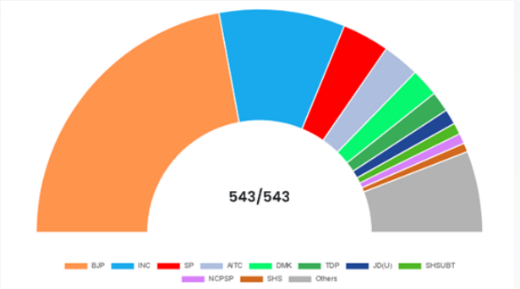
KEY INSIGHT
1) BJP acquires highest number of seats in election 2024- 240/543

Slide 4
Parties like TDP with 16 seats in Andhra Pradesh and DMK with 22 seats in Tamil Nadu made there mark in 2024 lok sabh elections while All India Trimool Congress got the 4th highest seat after being a regional party.
The three graphs shown below tells the involvement of regional parties is more than the national parties in some state
2) INFLUENCE OF REGIONAL PARTIES

Slide 5
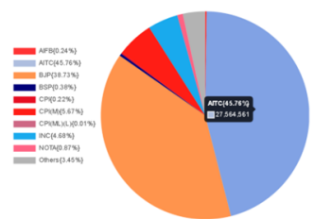
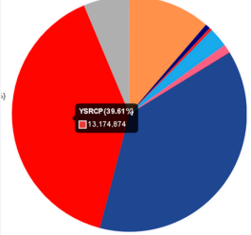
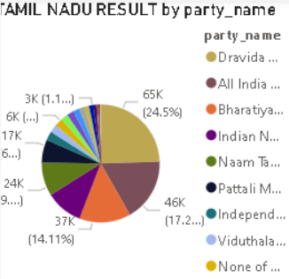
AITC WITH 45% VOTES WHILE BJP GOT 39%
TDP WITH 135 SEATS YSRCP 11 SEATS AND BJP 8 SEATS
DMK WITH 22 SEATS AND INC WITH 9 SEATS AS SECOND HIGHEST

Slide 6
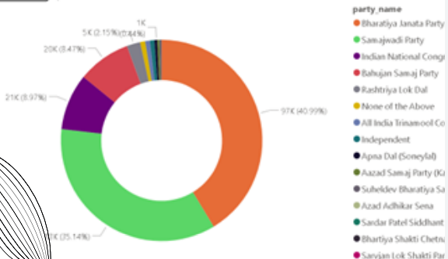
3) UNEXPECTED LOSS FOR BJP IN UTTAR PRADESH
The contest between these parties was pretty close but at the end
Samajwadi party’s cycle prevailed in the end Samajwadi party won the 37 seats
BJP won 33 seats
Big blow for BJP was the loss in Ayodhya

Slide 7
Total number of NOTA voters for the elction 2024 were 6,372,220
The percentage of NOTA voters is around 0.99%
This is high from the previous years
4) RISE IN THE NUMBER OF NOTA VOTERS

Slide 8
Independent candidates have shown a great performance where the won 7 seats.
There were total 3920 independent candidates who have made there presence felt in this election.
5) THE PERFORMANCE OF INDEPENDENT CANDIDATES

Slide 9
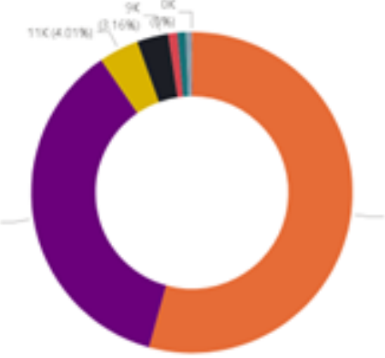
6) BY Election in Gujarat
BJP winning almost
all the seats in
Gujarat’s by election
INC was able to win 1
seat.
BJP won 22

Slide 10
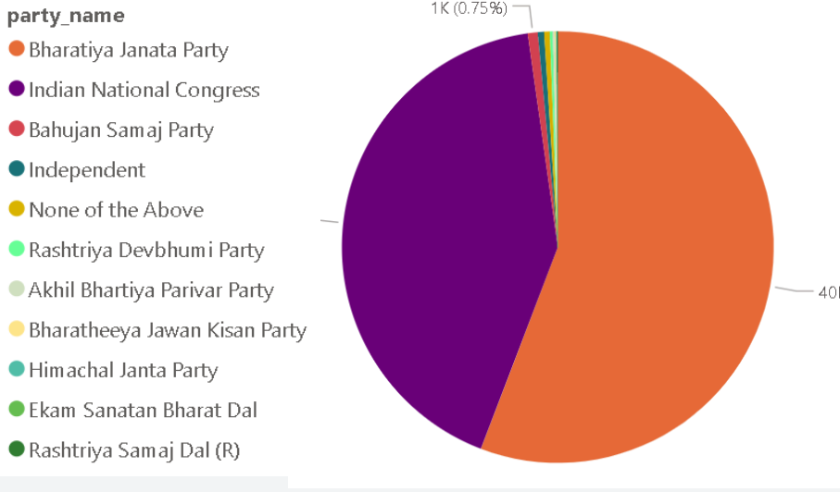
7) BY Election in Himachal Pradesh
In Himachal by elections where held in 6 constituencies
BJP Won 2 seats from Dharamshala and Barsar INC WON 4 Seats from Lahaul, Gagret, Sujanpur and Kutlehar

Slide 11
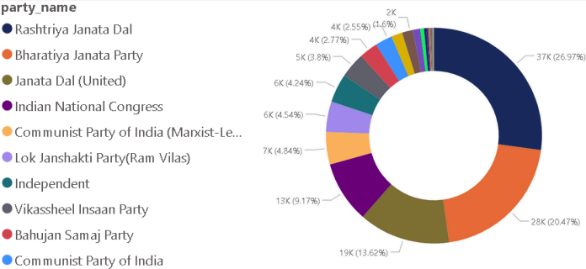
9)TIE BETWEEN BJP AND JDU
There were three main parties JDU,BJP,JRD. BJP got 20.53% and RJD got 22.14%
Both BJP AND JDU both got 12 seats .

Slide 12
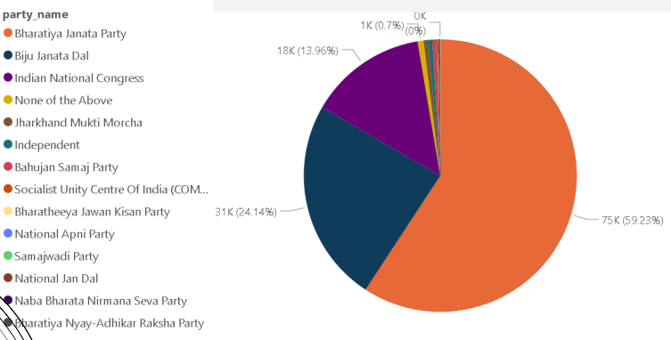
8) COMPETITION IN ODISHA
There was a competition in odisha between BJP and BJD
BJD got 37.53% votes and BJP got 45.34% votes

Slide 13
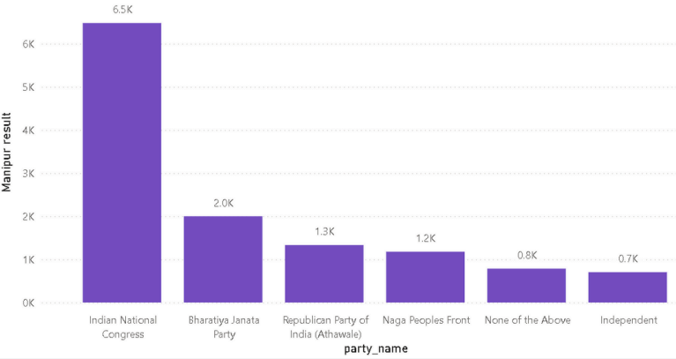
10) BIG WIN FOR INC IN MANIPUR
Big win for INC in Manipur where BJP has failed to win 1 seat
INC won 2 seats in Manipur

Slide 14
It was seen that the parties that are able to achieve votes in constituency election are failing to achieve the seats in state election
It was different in the case of Andhra Pradesh where the ruling state government was not able to acheive the seats
In Bihar it was 50-50 for two parties BJP and JDU
11)DIFFERENCE BETWEEN STATE AND CONSTITUENCY RESULTS

Slide 15
In Lok Sabha Election 2024, more than 968 million people out of a population of 1.4 billion people were eligible to vote, equivalent to 70 percent of the total population. The general elections were held from 19 April to 1 June 2024 in seven phases, to elect the 543 members of Lok Sabha.The election ends with the Victory of Bharatiya Janta Party, securing 37.36% of 303 seats and stabilizing its third consecutive working tenure.
CONCLUSION

